Slide 1
DIABETES
INTELLECT
Project Head: Mayank Sharma

Slide 2
IDEA: Smarter Way To Manage Blood Glucose Levels
CATEGORY: Mobile App Development & Web Development
GLUCOMETER
Glucometer that always sync your reading to a specially designed mobile application that analyse all the reading carefully and help monitoring and managing the diabetes the smarter way.
MOBILE APPLICATION
An app that will help the user to manage and monitor their blood glucose level in a smarter way. It will also provide personalised diet and exercise routine for better HbA1c result.

Slide 3
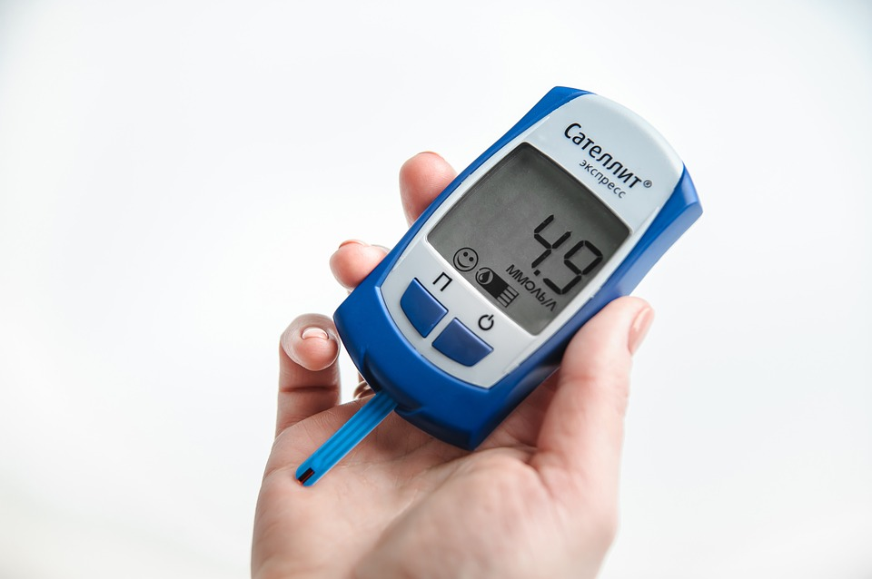

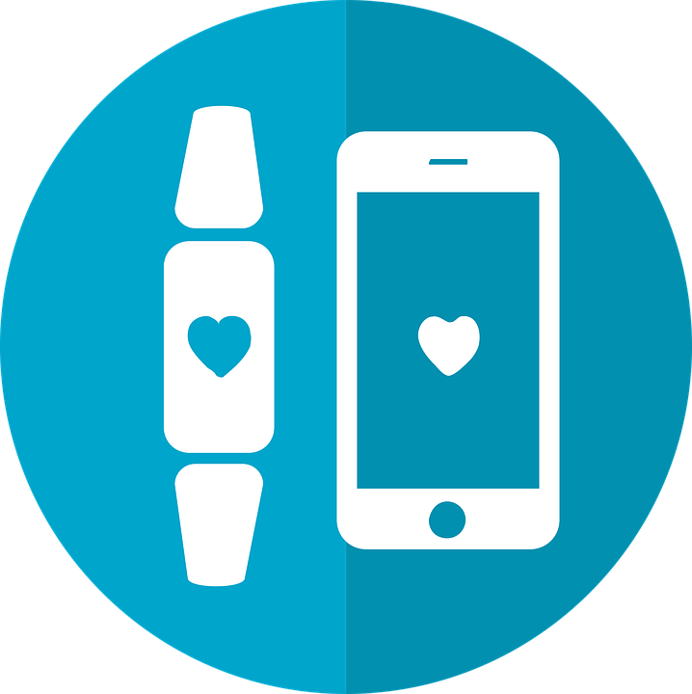

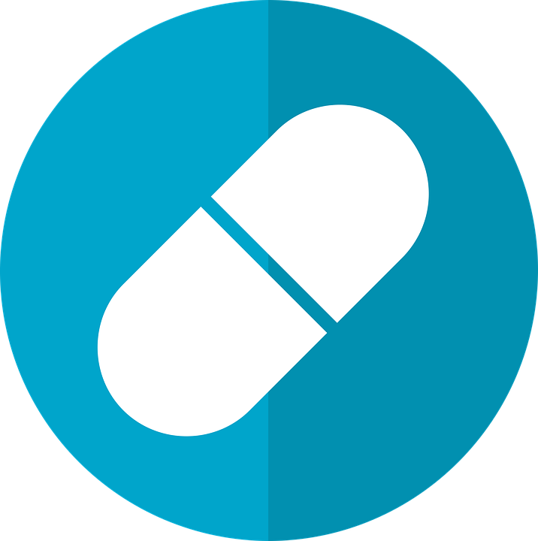
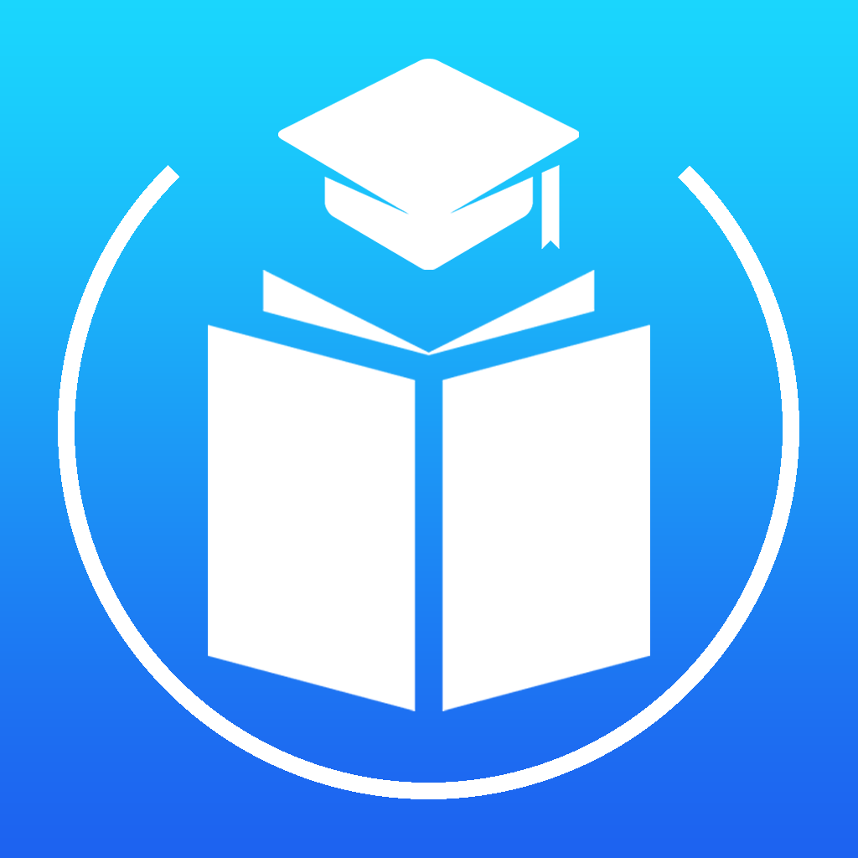

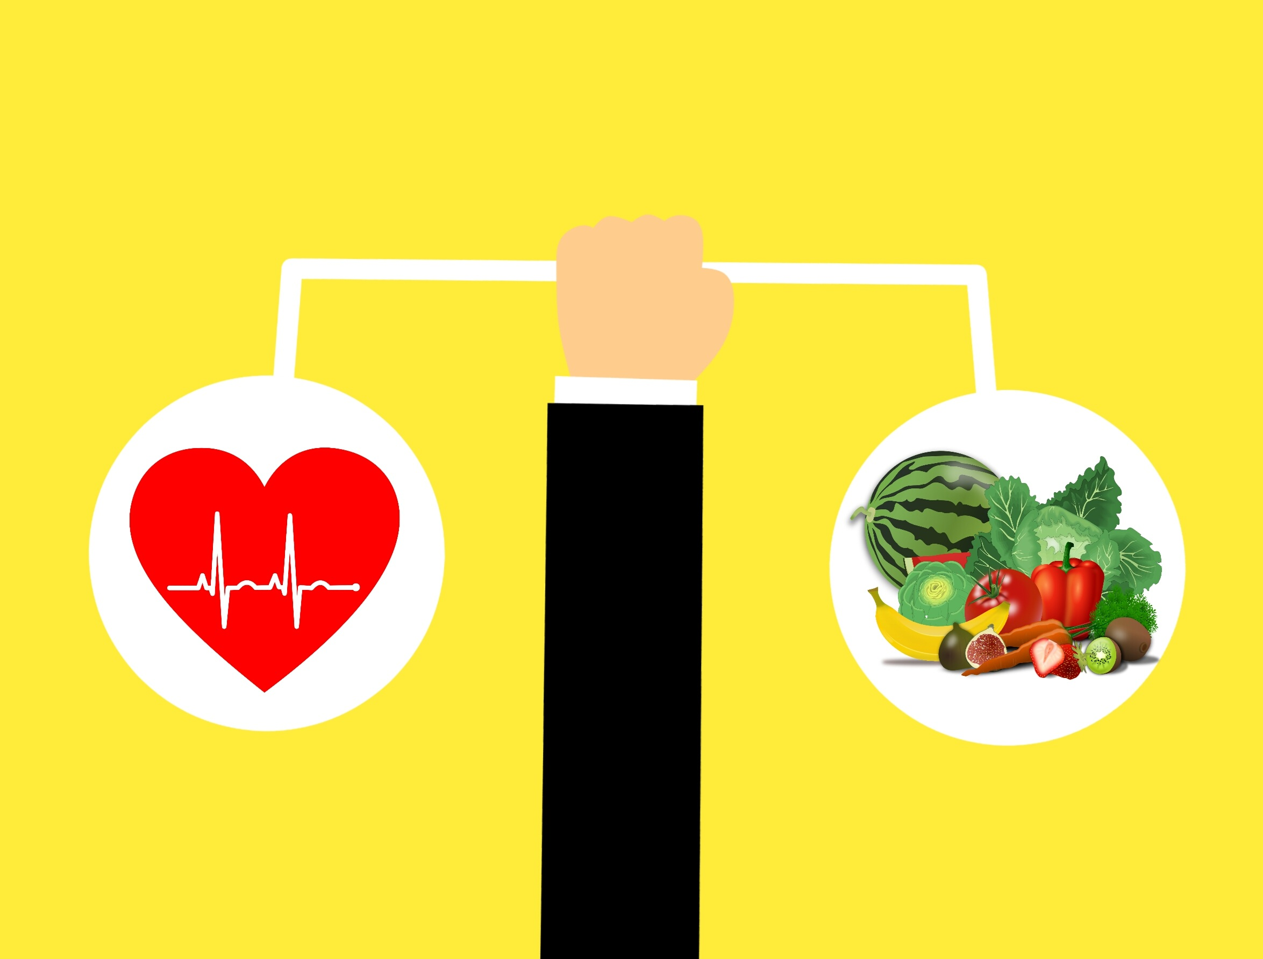
Categories in our application
1
Monitoring and Managing
2
Doctor and Dietician Consultation
3
Sync Fitness Tracker
4
Personalised Diet and Exercise Routine
5
Online Pharmacy and Lab Test
6
Learn About Diabetes
7
Reminders
8
Food calories indicator

Slide 4
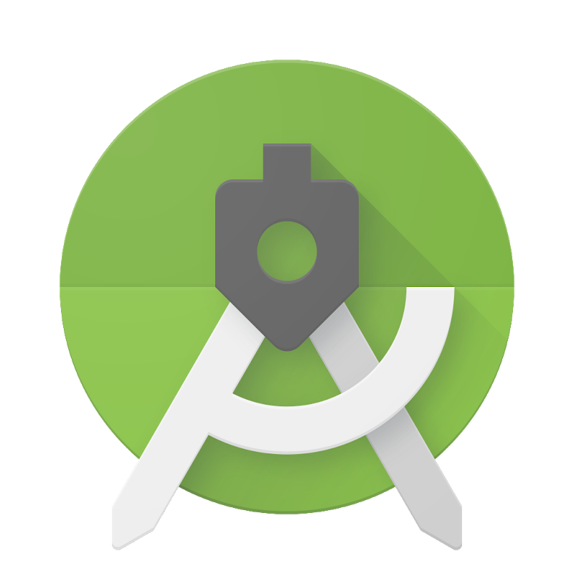
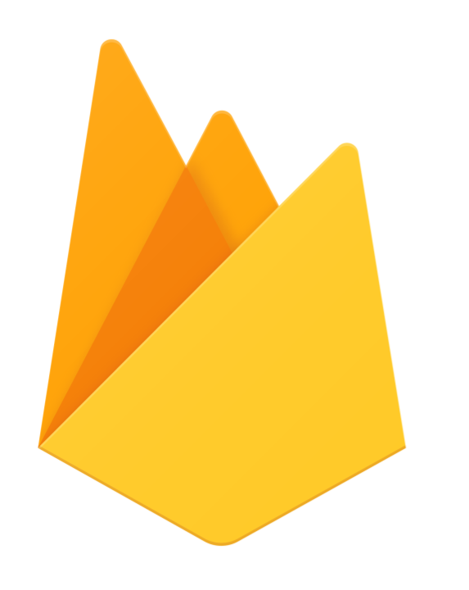
TECHNOLOGY USED IN OUR APPLICATION
Android Studio & Swift language
Our application is aiming to provide maximum access to information in hands of Patient in most efficient way.
To accomplish this we will be making use of various pre-built third party API’s.
We are developing an Android Application as well as a ios app hence Android Studio and swift language will used as Developing Environment.
For data management we will be using SQL and JSON database.
Languages used are Java , Python & JSON.
We will be using a python server so as to serve the information.
Android studio and swift will be the developing environment for our application.
Material Design
Material design components and guidelines will be used to provide good UI/UX experience to user.
Google Cloud Auto-ML
Machine Learning models will be used for analyzing & detecting Plant Disease.
Firebase
Firebase is used for Realtime Database and Cloud messaging as a service.
Third Party API’s
Several API’s will be used in application for retrieving data from various sources.
Programing Languages
Java, Python and JSON will be used for developing the application module

Slide 5
Use case and Dependency
Use cases and dependencies has been defined here.
Use Case
Dependencies
.
It is Estimated that 415 Million People are living with diabetes in the world, which is estimated to be 1 in 11 of the world’s adult population. 46% of people with diabetes are undiagnosed.
The Global market for glucose monitoring device is expected to grow from US$10Billion in 2015 to US$12.4 in 2020.
By 2040 643Million People will have diabetes .
By 2040 diabetes related Health Expenditure Will Exceed US$802 Billion.
We are building an application which will cover the problems of diabetic patient and will provide efficient solutions to those problems . The only dependency is that the data provided by the patient must be provided in correct order with respect to the meals i.e (patient have to specify whether the given reading from glucometer is the fasting one or after meals reading )
Hence overall we have a minor dependency which can be resolved easily.

